Slide 1


Impact of Science Conference the Parallel Session on:
Public Engagement and Co-Creation
23rd June, 2021

Slide 2
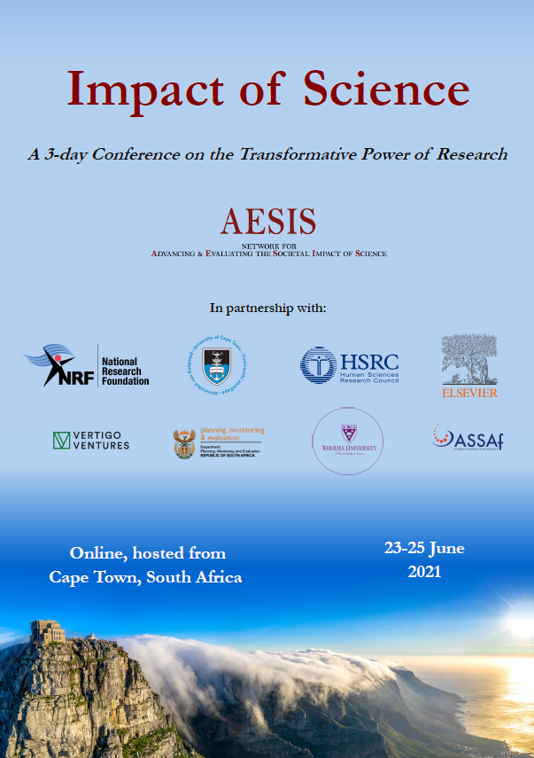

Impact of Science
23-25 June, 2021
Rasigan Maharajh (Chair): Node Head, Department of S&T and NRF Centre of Excellence in Scientometrics and S&T and Innovation Policy, South Africa
Jenny Hasenfuss: Coordinator, Capabilities in Academic Policy Engagement (CAPE) Unit, Northumbria University
Diana Sanchez-Betancourt: Senior Researcher at Human Sciences Research Council, South Africa
Overview of the Speakers
#IOS21

Slide 3
Impact of Science
23-25 June, 2021
Rasigan Maharajh
Node Head, Department of S&T and NRF Centre of Excellence in Scientometrics and S&T and Innovation Policy, South Africa
#IOS21

Slide 4
Public Engagement & Co-Creation
Rasigan Maharajh,
Impact of Science Conference: The Transformative Power of Research,
Network for Advancing and Evaluating the Societal Impact of Science, 23 June 2021, Zoom.

Slide 5
Outline
Introduction to Session
Introduction to Speakers
Brief Overview on Public Engagement and Co-Creation
Conclusions
References

Slide 6
Introduction: Public Engagement & Co-Creation Session
Introduction on the topic and speakers, and presentation by the chair: Rasigan Maharajh– 10/15 minutes
Speaker-Presentation 1: Jenny Hasenfuss– 15/20 minutes
Speaker-Presentation 2: Diana Sanchez Betancourt– 15/20 minutes
General Discussion and Q&A led by the chair – 20/25 minutes
Rasigan Maharajh is concurrently Nodal Head of the Department of Science and Technology and National Research Foundation’ Centre of Excellence in Scientometrics and Science, Technology and Innovation Policy; the founding Chief Director of the Institute for Economic Research on Innovation at Tshwane University of Technology; an Associate Research Fellow of the Tellus Institute in Boston; and the Chairperson of the Southern Africa Node of the Millennium Project.
Rasigan was previously: Professor Extraordinary of the Centre for Research on Evaluation, Science and Technology at Stellenbosch University; Visiting Professor at Rede de Pesquisa em Sistemas e Arranjos Produtivos e Inovativos Locais in the Instituto de Economia of the Federal University of Rio de Janeiro, Brazil; Visiting Research Scholar at the George Perkins Marsh Institute of Clark University, USA; Head of Policy at the Council for Scientific and Industrial Research; and National Coordinator of the Science and Technology Policy Transition Project for South Africa’s first democratic government. Before these deployments, Rasigan was: Senior Researcher at the Education Policy Unit of the University of Natal; National Coordinator and Researcher at Operation Upgrade of Southern Africa; Research Assistant at the Macro-Education Policy Unit of the University of Durban-Westville; Research Assistant at the Labour and Community Project of the South African Council for Higher Education; and a Casual Labourer at Pick and Pay Supermarkets.
During the struggle against the apartheid regime, Rasigan held elected leadership positions within the: United Democratic Front, Congress of South African Trade Unions, and the African National Congress. Rasigan was awarded a Doctor of Philosophy degree by the Forskningspolitiska Institutet (Research Policy Institute), School of Economics and Management, Lund University, Sweden; and he is also an alumnus of the University of KwaZulu-Natal of South Africa and the Harvard Business School of the United States. Rasigan is a Ministerial Representative on the Council of Rhodes University and an elected Senator of Tshwane University of Technology. Since 2004, Rasigan has contributed to more than 65 publications, and has presented his research in 42 countries.

Slide 7
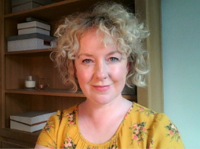
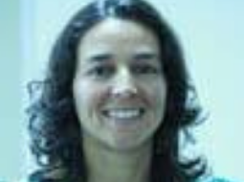
Introduction to Speakers
Jenny Hasenfuss is a knowledge exchange professional with experience of supporting research engagement and research impact. With more than ten years' experience in the UK Higher Education Sector she is passionate about the importance of dialogue and trust in creating great research partnerships in order to make a positive difference to society. Currently she works with the CAPE partnership to enable greater understanding and cooperation between universities, regional and local authorities and national government and seeks to ensure the project activity reflects the diversity of England’s communities.
Previously she led public and patient engagement activities of the NIHR BTRU Organ Donation and Transplantation between University of Cambridge and Newcastle University. Before that she coordinated the cross-disciplinary research Newcastle University Institute for Social Renewal which involved working with policy makers, community and voluntary sector and businesses to develop impactful challenge-based research in partnership. As part of the European Horizon 2020 project ACCOMPLISSH www.accomplissh.eu she examined collaborative multi agency working in the Quadruple Helix framework across 12 countries and how this can support impactful research. Recently she co-developed a co-creation toolkit in collaboration with Carnegie Trust UK, Newcastle University and a range of external partners to support effective knowledge exchange and impact.
Diana Sanchez Betancourt is a Chief Researcher at the HSRC. She did her Masters at the Department of Peace and Conflict Studies Uppsala University in Sweden. She is an International Social Sciences Council (ISSC) World Social Science Fellow on sustainable urbanisation since 2012, and is a co-founder of the citizen-based urban movement Open Streets Cape Town.
Her career started working for the Colombian Government (her home country) monitoring multi-stakeholder collaborative mechanisms to assist populations at risk in conflict areas. Some of her recent work includes; thematic leader of the citizen engagement governance work stream for National Treasury piloting mechanisms to improve community engagement and service delivery in South African cities; Implementing a collaborative (municipality & community) Community Scorecard Process with the City of Cape Town to improve the provision of Water and Electricity; ethnographic field work coordinator for the Safer and Inclusive Cities programme on social Cohesion and safety (comparative project South Africa - Brazil) and thematic coordinator for two inter-continental learning alliances (on Citizen Oversight and Human Rights) for the UK funded Evidence and Lessons from Latin America Programme- ELLA.
Notes:
Jenny Hasenfuss’s presentation focuses on practical case studies of public engagement activities which hopefully complements the academic and theoretical content of the programme
Diana Sanchez Betancourt presentation draws on her work in the Open Streets Cape Town Project, a citizen-driven initiative working to change how we use, perceive and experience streets.

Slide 8
Overview on Public Engagement & Co-Creation
Public engagement processes emerge from earlier attempts across history of broadening the participation and access by non-professionally trained people with the praxis of science and was very prominent in the various ‘people’s science’ movements and initiatives that sought to tighten the relationship between science and society in the 20th Century
“…polarisation, populism, and low levels of trust in governments have prompted academics, practitioners, politicians, and policy makers to reflect upon innovative ways of breathing new life into democratic institutions”
(Cesnulaityte, in Maharajh, 2021a).
“In responding to the challenges of the contemporary conjuncture, research councils can expect further demands on the performance of science and technology agencies.
By engaging with the public on, and with, science, research councils can also influence the course of human history and encourage the building of resilience and sustainability of humanity on the planet.
Realising such progressive ambitions requires that research councils are themselves properly resourced, capacitated, and competent in the deployment of public engagement approaches for the purposes of mutual learning and socio-economic and political development for all”
(Maharajh, 2021a)

Slide 9
Statement of Principles on Public Engagement (2020)
Global Research Council participants …
recognise public engagement as purposeful and meaningful activities facilitated between researchers and their various ‘publics’, whereby the co-construction of knowledge is enhanced, and mutual learning generates benefits for all.
agree that specifically targeted, and nuanced approaches are required to maximise critical engagement with science by the various publics within their respective knowledge ecosystems.
recognise changes in the mandates of public funding agencies, from their historical roles in exclusively, yet narrowly, funding research towards including the funding of public engagement.
agree that knowledge co-creation with various publics takes place at all stages of the research process, including upstream: through the identification and development of research priorities and strategies; midstream: through the involvement of publics in research; and downstream: through the public’s benefit from, and understanding of the impact and scientific output of research.
acknowledge that an appropriate leveraging of resources is required to further support and facilitate wider public engagements with science.
acknowledge that the sharing of monitoring, evaluating, and learning metrics for public engagement will assist national funding agencies in improving their organisational capabilities, encouraging inter-institutional partnerships, and promoting increased public investments in the enterprises of science.
Source: Maharajh, 2021a

Slide 10
Conclusions
Widen and Expand Public Engagements in Science, Technology, and Innovation
  Rebuild Trust in Science
  Redress Alternative Facts
Co-construct the World we Want,
  Need, and
  Demand!

Slide 11
References
Alexander, Neville. 1990. Education and the Struggle for National Liberation in South Africa, Skotaville Publishers, Johannesburg.
Guterres, António Manuel de Oliveira. 2020. Tackling the Inequality Pandemic: A New Social Contract for a New Era, 18th Nelson Mandela Lecture, Nelson Mandela Foundation, Johannesburg, 18 July.
Maharajh, Rasigan. 2021a. 21st Century Public Engagement and Mission-orientated Research: Advancing Sustainable Futures for All, Global Research Council, London.
Maharajh, Rasigan. 2021b. A Vaccine Against Intellectual Hubris, Errant Journal 1(2): 77-81.
UNCTAD. 2020. The Need to Protect Science, Technology and Innovation Funding During and After the Covid-19 Crisis, United Nations Conference on Trade and Development, Geneva.

Slide 12
Dankie
Thank you
Ngiyathokoza
Enkosi
Ngiyabonga
Ke a leboga
Ke a leboha
Ke a leboga
Siyabonga
Ndo livhuwa/ Ro livhuwa
Inkomu
rasigan@ieri.org.za
www.ieri.org.za
Faculty of Economics & Finance,
Tshwane University of Technology,
159 Nana Sita Street,
Pretoria CBD, 0002,
Gauteng Province,
Republic of South Africa.

Slide 13
Public Science, Agency, and Engagement
Research councils remain essential components of all states in world systems. Research councils are accountable to the public at large and especially through the governments that are constituted with temporal mandates from the citizenry of the various national systems. Governments collect revenues from the societies they govern for the purposes of advancing socio-economic and political development of their citizens. It is these public resources that are entrusted to research councils for the purposes of advancing knowledge frontiers and addressing bio-physical and social challenges of the conjuncture.
Thus, whilst research councils are accountable to the State for the agency afforded to them, many are also accountable to the communities of scientists that they support in the advancement of knowledge and the derivation of applications which improve their material lives; and to various publics that are ultimately beneficiaries of the investments made on their behalf.
“In responding to the challenges of the contemporary conjuncture, research councils can expect further demands on the performance of science and technology agencies.
By engaging with the public on, and with, science, research councils can also influence the course of human history and encourage the building of resilience and sustainability of humanity on the planet.
Realising such progressive ambitions requires that research councils are themselves properly resourced, capacitated, and competent in the deployment of public engagement approaches for the purposes of mutual learning and socio-economic and political development for all”
Source: Maharajh, 2021a

Slide 14
Impact of Science
23-25 June, 2021
Jenny Hasenfuss
Coordinator, Capabilities in Academic Policy Engagement (CAPE) Unit, Northumbria University, United Kingdom
#IOS21

Slide 15

Co-creation of knowledge-
Fertile conditions in the research ecosystem?
AESIS Impact of Science “The Transformative Power of Research” 23 June 2021
Public Engagement and Co-Creation Panel: The Importance of Society Should Not be Underestimated: How Can You Effectively Connect with Stakeholders
Jenny Hasenfuss, Northumbria University, Newcastle upon Tyne, United Kingdom
Email :jenny.Hasenfuss@northumbria.ac.uk
Notes:
This presentation will focus upon some of the key aspects of how to support effective co-creation with societal stakeholders.
This presentation is not exhaustive or comprehensive of the whole public engagement field which is extensive, broad and growing.
Rather it will centre upon a method for stakeholder involvement developed in England.
Co-creation toolkit example: This co-produced toolkit developed in England with a range of partners
Key principles for connecting with stakeholders to cultivate and nourish effective engagement and involvement for impactful research
Will consider three areas of pertinence in UK setting of research ecosystem:
Public engagement,
patient engagement,
policy engagement

Slide 16
Working together to co-create knowledge:
A unique co-creation tool
Builds upon work started in the Horizon 2020 ACCOMPLISSH project; a consortium of 13 universities across 12 countries
Survey, literature review, roundtable discussions exploring the ‘quadruple helix’ model: Collaboration between university, business, local authority and the third sector
https://www.carnegieuktrust.org.uk/publications/working-together-to-co-create-knowledge-a-unique-co-creation-tool/
https://www.carnegieuktrust.org.uk/publications/collaboration-tool
Notes:
Credits:
This booklet was developed by:
Caroline Afolabi, Success4All
Pippa Coutts, Carnegie UK Trust
Jeremy Cripps, Children North East
Simon Hanson, Federation of Small Businesses
Jenny Hasenfuss, Newcastle University
Phillip Hunter, Newcastle City Council
Karen Laing, Newcastle University
Mark Shucksmith, Newcastle University
Thanks also go to all those too numerous to name who took part in our discussions around what a toolkit for co-creation might look like. We are indebted to you all.

Slide 17
Key Principles of
Co-creation
Some challenges are too big and complex for one organisation to tackle alone, and need multiple perspectives
Time is needed to build trust, and everyone’s time and knowledge needs to be valued
Once trust is established, the project should have a united and clear sense of purpose which is understood and shared by partners
Each partner needs to benefit from the co-creation, but this benefit can take different forms
https://www.carnegieuktrust.org.uk/publications/working-together-to-co-create-knowledge-a-unique-co-creation-tool/

Slide 18
Rational and Relational Lexicons of Public Policy
Unwin(2018)
Rational- balanced, scrutiny, targets, data, systems, processes
Relational- connection, wellbeing, relationships, trust, belonging, challenge
Unless we find better and more understandable ways of focusing on our shared humanity, we risk a very sterile, and very much less effective, social settlement. And we risk entrenching gross inequalities of power which prevent us achieving our shared goals.
https://www.carnegieuktrust.org.uk/publications/kindness-emotions-and-human-relationships-the-blind-spot-in-public-policy/
Notes:
The blend and balance of rational and relational aspects as explored by Julia Unwin in 2018 became a central component of the toolkit:
The Scottish Government in 2018 adopted kindness as one of its core values in its 2018 National Kindness, emotions and human relationships 30 Performance Framework (Scottish Government, 2018).
As a piece of statecraft this is ground breaking and significant. And it has well recognised implications in a number of directions but specifically: Measuring and auditing for kindness Policy design for kindness Regulating for kindness The challenge is to ensure that the great potential of this commitment does drive the higher levels of trust, and engagement, that those designing the framework intend.

Slide 19
Public Engagement
From public engagement ….. Towards public involvement
UK Research Excellence Framework (REF) and Impact Case Studies
Owen, D, Featherstone, H, Leslie, K (2016) ‘State of Play’ report
UK Knowledge Exchange Framework (KEF)
Lay/peer researchers
Citizen science
Notes:
Rational:
Relational:

Slide 20
Patient Involvement
“..science must enter the agora and participate fully in the production of socially robust knowledge” Gibbons, M (1999)
Patient voice and priorities (e.g. James Lind Alliance)
Creative methods to share perspectives
Role of Lay co-applicants in research projects
NIHR Centre for Engagement and Dissemination
Notes:
Example of patient engagement (NIHR funding rational,
brokerage staff who know rational and relational,
trust and communication= relational,

Slide 21

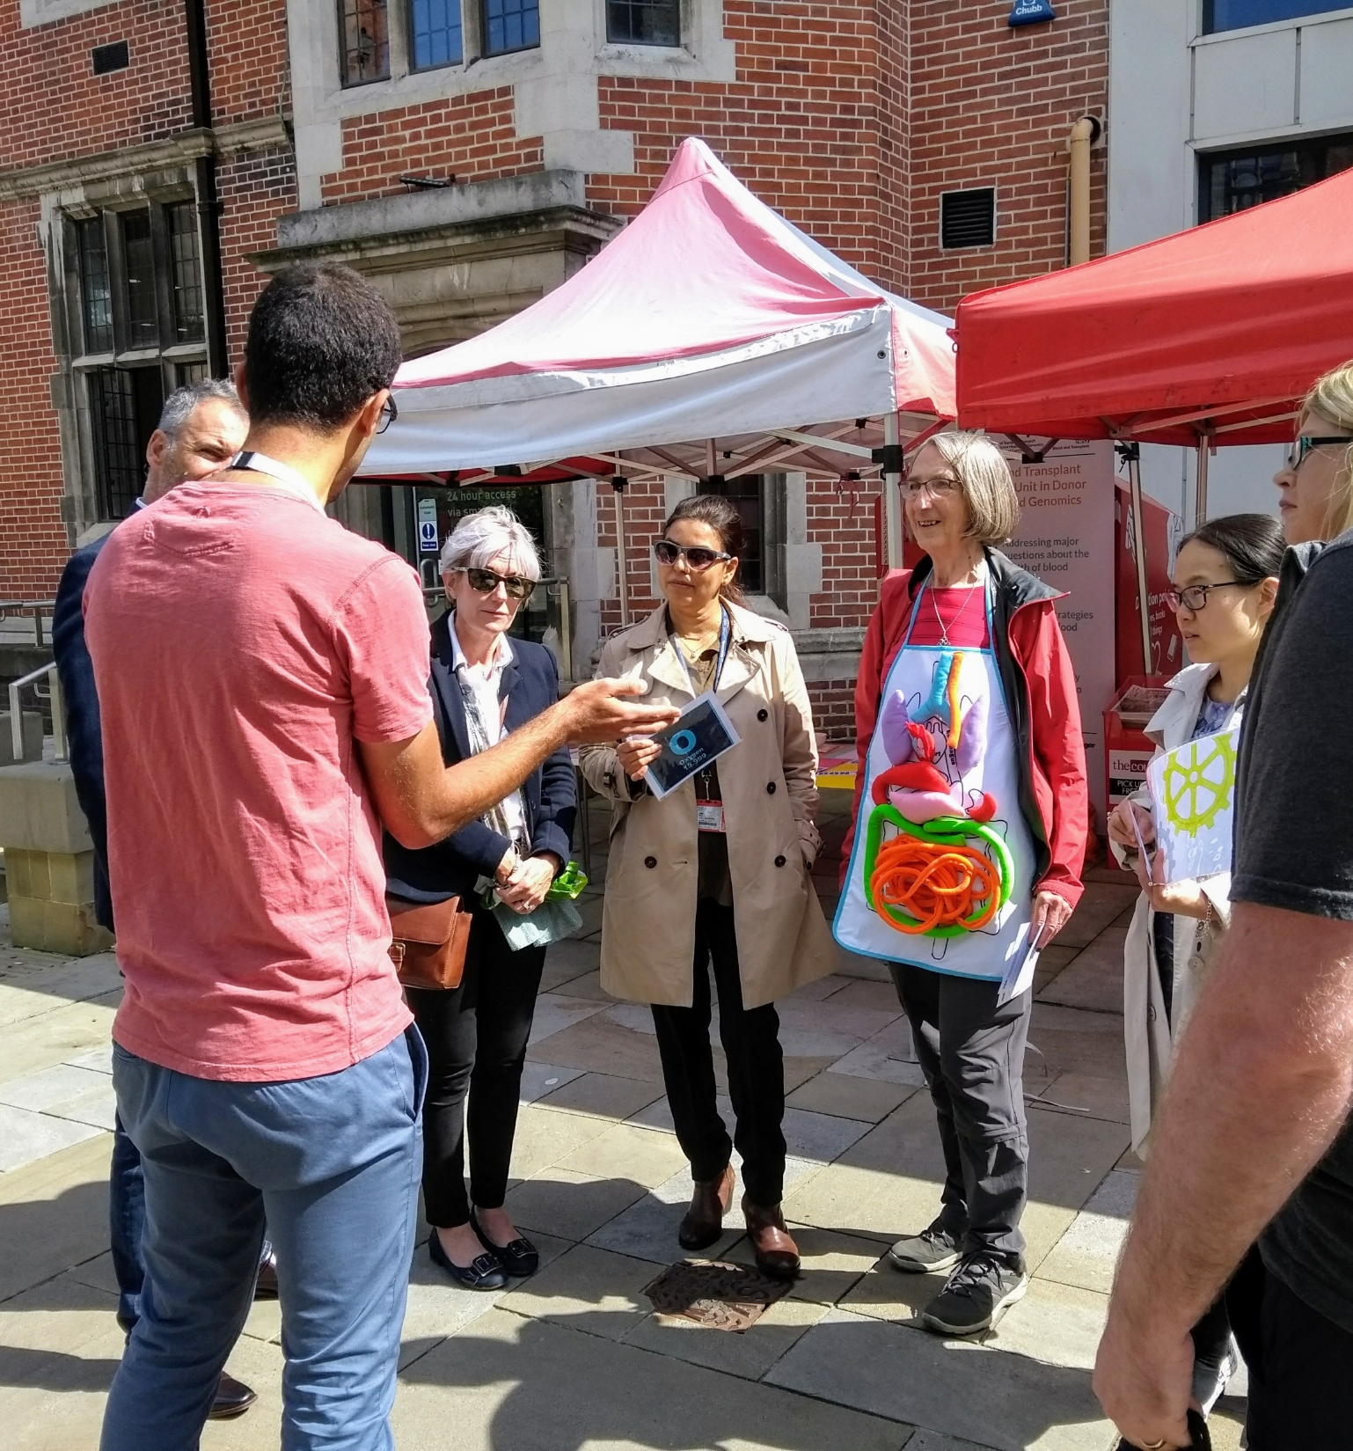
Once we were strangers,
Brought together by a cause,
Friendship blossoms here
http://odt.btru.nihr.ac.uk/get-involved/btru-haiku-poetry-collection/

Slide 22

Policy Engagement
Potential for greater dialogue, mutual understanding of rational domains, creativity and innovation, diversification of actors, and collaboration and shared outcomes
Notes:
Metz, A, Boaz, A, Robert, GB
‘Co-creative approaches to knowledge production : what next for bridging the research to practice gap?’”

Slide 23
Looking Ahead
Elsevier and Ipsos Mori (2019) Research Futures-drivers and scenarios for the next decade
open access and digital technologies, focus upon rapid development of practical solutions
data analytics and change in blend of funders and who sets research agenda
internationalisation of research, country investment varied, questions around who owns data and how & when it will be shared; and questions around alignment of research goals
Where does the public fit in future research ecosystem scenarios?
Notes:
Fertile conditions? Base, energy, seed, care, time. ~find definition of ecosystem

Slide 24
References
Geddes, M, Dommett, K, Prosser, B A recipe for impact? Exploring knowledge requirements in the UK Parliament and beyond,
Gibbons, M. Science's new social contract with society. (1999) Nature 402, C81–C84
Schütz, F, Heidingsfelder, M, Schraudner, M, Co-shaping the Future in Quadruple Helix Innovation Systems: Uncovering Public Preferences toward Participatory Research and Innovation, She Ji: The Journal of Design, Economics, and Innovation2019, 5 (2):128-146
Laing K, Bertosa M, Hriberski D, Hasenfuss J, Shucksmith M, Todd L, Tewdwr-Jones M, Sutrop M, Parder M, Lõuk K, Vabamäe E (2017). Principles for promoting the impact of SSH research by co-creation: key issues in research design and communication.
Leydesdorff, L. The Triple Helix, Quadruple Helix, and an N-Tuple of Helices: Explanatory Models for Analyzing the Knowledge-Based Economy?. J Knowl Econ 3, 25–35 (2012)
Metz, A, Boaz, A & Robert, GB, Co-creative approaches to knowledge production: what next for bridging the research to practice gap?': A Journal of Research, Debate and Practice, The Policy Press, University of Bristol, vol. 15, no. 3, pp. 331-337
Stoetzler M, Yuval-Davis N. Standpoint theory, situated knowledge and the situated imagination. Feminist Theory. 2002;3(3):315-333.
Unwin,J (2018) Kindness, emotions and human relationships: The blind spot in public policy, Carnegie Trust UK.

Slide 25
Impact of Science
23-25 June, 2021
Diana Sanchez-Betancourt
Senior Researcher at Human Sciences Research Council, South Africa
#IOS21

Slide 26
Public Engagement and Co-Creation
Methods and Strategies for Stimulating Social Impact at the Urban Governance Scale
Diana Sanchez Betancourt
Human Sciences Research Council

Slide 27
SOCIAL RESEARCH IN THE URBAN CONTEXT
Current challenges require collaborations:
Rapid urbanisation, growing informality and weak local governance
Overstretched institutional capacity in cities (not only in SA, throughout the global South).
The 3rd global wave of public administration reforms aimed at co-production between government and citizens

Slide 28
Stimulating Social Impact: Questions to consider
Existing research approaches for engaging citizens and communities are limited in their capacity to gain understandings of rapidly changing local contexts and nurture collaborations ,therefore in their contribution to solve problems, so:
  How to develop collaborative frameworks for co-producing knowledge and having social impact?
  How can research institutions (like the HSRC) support the development of better urban governance practices through research?

Slide 29
A broader disciplinary lens needed?
It seems traditional social science approaches are insufficient for providing transformative ideas for solving urban problems and managing increasing urban tensions
3 sources of limitations:
  Disciplinary focus; limited to public administration, political science, urban planning
  Dimensionally: Ignore or downplay the relational dimensions of urban dynamics, specifically those between the inner and outer dimensions of being citizens and officials
  Intellectually: Preference for linear production of knowledge at expense of the more local and organic developed ‘understandings’.

Slide 30
Insights from 3 Action Research Projects 2013-2018:
These projects aimed to:
  Understanding how Cities (public officials) approach community engagement
  Gathering the experiences of Civil Society and communities around urban challenges
  Piloting participatory methodologies to improve relations and interactions (city – citizens).
  Exploring how could government and researchers work together with residents of informal settlements to co-develop strategies to improve challenges around public services

Slide 31
How did we go about it?
We followed the principles of Participatory Action Research: A collective and self-reflective inquiry that aims to understand and improve local circumstances and practices.
We experimented with existing methodologies, adapting tools to the local context
We slowly build a working relationship to enable working simultaneously, and then jointly with city officials and communities

Slide 32
Method: The Community Scorecard Process
Brings together citizens and officials (users and providers)
To decide key issues and co- develop measures (the scorecard)
To evaluate challenges and ways to improve delivery and maintenance of services (water and electricity)

Slide 33
First Pilot Project: The project team
Researchers & Facilitator
2 Researchers
Community leaders
10 Leaders from the local communities
City officials
11 Departments
Community residents
42 Residents
1 External facilitator
17 Individuals

Slide 34
Project Video
(9 min)
https://www.youtube.com/watch?v=Uy7ux6ni3Io

Slide 35
Community Scorecard: A tool for constructive dialogue
Process resulted in tangible results in the form of scorecards, indicators and data (statistics, ideas, scores)
But the most powerful results were around the intangibles.
Namely the relationships that emerged, the trust that was developed in a very confrontational environment and validating citizens’ understandings of very complex and obscured localised realities.
These lessons highlight the value of the relational dimension of governance, the importance of validating the soft or intangible outcomes of research exercises and co-producing knowledge.
Notes:
The community scorecard process taught is that in order to improve local governance we need to change the way we observe local problems and we relate to each other
So to improve citizen and community engagement and enhance collective well-being we need to learn to collaborate
Informing this transformation requires a broader disciplinary lens

Slide 36
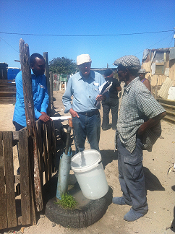
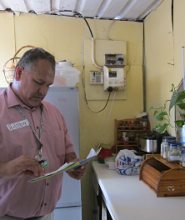
Being part of daily experiences through visits and dialogues

Slide 37
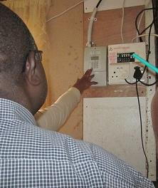
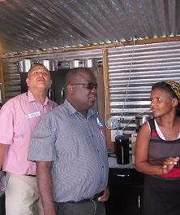
Sharing knowledge: Officials and residents

Slide 38
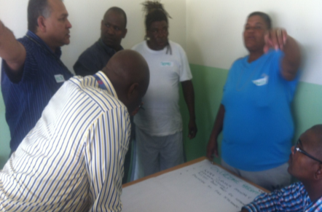
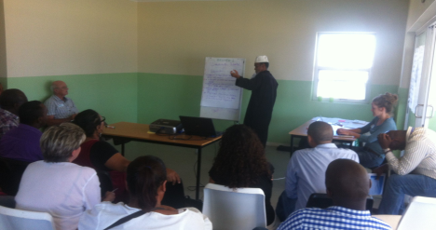
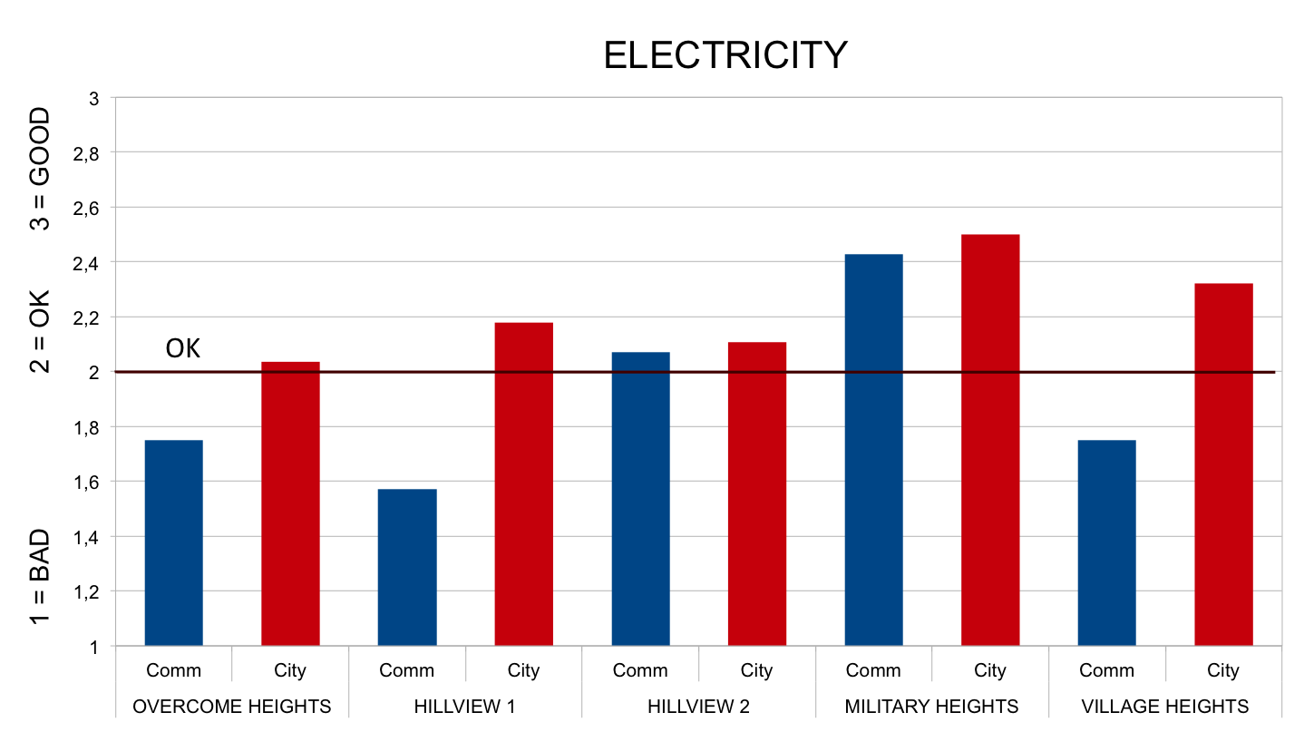
Joint discussion of results and ideas for action: Facilitated by Researchers
IDEAS / ACTIONS | CHAMPS | COMMENTS
Monthly com. leaders’ meetings | Aysha to organize 1st meeting | Rotational basis for hosting and organizing; Invite the councillor
Scorecard team meetings | Fawzia, Charmaine, Alie | Have follow-up and action meetings in /every 2 months
Fit refuse containers with chutes to throw bags when locked | Thembi and Brent | Meet to explore idea to see if there is potential
Display call-centre numbers in strategic locations | Utiities | Current placement not effectiven

Slide 39
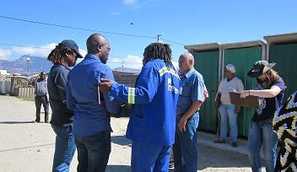
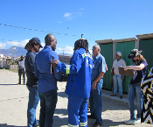
“We tend to engage in desktop scoring but it’s useful to be on the ground listening.” City Official

Slide 40
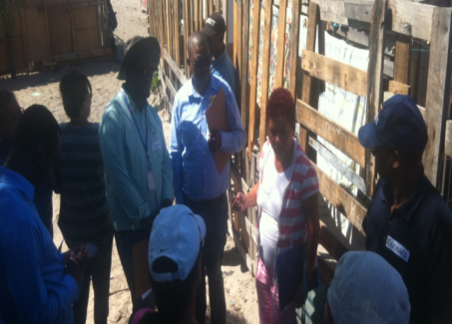
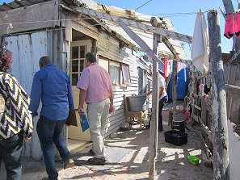
“I was beginning to lose hope … after this I can see there is hope … I can see the community also shares our challenges and frustrations.” City Official

Slide 41
Experiential and Collaborative Research
Experiential learning transforms understanding and builds relationships.
Creating spaces for dialogue is key: new understandings of processes and limitations - both within communities and municipalities - emerges through dialogue.
Shared knowledge: community knowledge, combined with Public Official’s knowledge and enriched by researchers is key to generate better solutions.
Informal interactions: better engagement and research upotake, depends heavily on relationship-building, which often occurs through informal interactions and “soft spaces.”

Slide 42
Concluding Reflections
Social research could be transformative through implementing experiential and collaborative approaches: experiential (on the ground, experiencing the issues) and collaborative (bringing together various stakeholders like government and citizens to reflect and act together;)
Social experimentation and research needs time, flexibility and resources.
Existing methods could be redesigned to serve specific purposes: The Community scorecard served as a valuable process of experiential learning.
In the urban research impact context, experiential learning was a way to strengthen collective action in order to address engagement and service delivery challenges.

Slide 43
THANK YOU
Diana Sanchez Betancourt
dsanchez@hsrc.ac.za

Slide 44
Impact of Science
23-25 June, 2021
Thank you
#IOS21

